Slide 1


G H RAISONI UNIVERSITY, AMRAVATI
G H Raisoni Nagar, Anjangaon Bari Road, Amravati, Pin: 444701(MH)
Phone: +91-8799928631/ +91-8799928630
Email: info.amravati@ghru.edu.in Web: - www.ghru.edu.in
Department of BCA
A Project
On
( Project Title )
Guide:
Guide Name
Name of Projectees
.
Session 2025-26

Slide 2
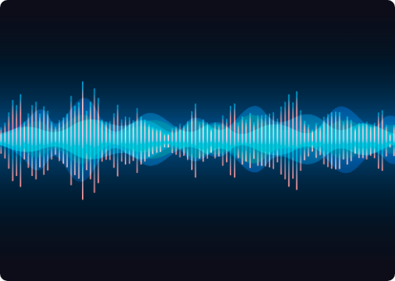
INTRODUCTION
The rise of Generative AI has fundamentally altered digital security. Audio deepfakes—synthetic speech created through high-fidelity voice cloning—have emerged as a critical threat to telecommunications.
Our project addresses this by proposing an Integrated Deepfake Detector that unifying acoustic forensics with real-time intent analysis.

Slide 3




LITERATURE REVIEW
Spectral Features
Neural Models
Intent Analysis
Research on MFCC and Constant-Q Transforms (CQT) captures "microscopic artifacts" in high-frequency regions.
Recent studies prove CNN-LSTM hybrid architectures outperform traditional SVM or GMM models in accuracy.
Modeling linguistic patterns (urgency cues, financial jargon) helps flag "vishing" scams before they succeed.

Slide 4

RESEARCH GAP
Multilingual Support: Lack of training on regional dialects like Marathi and Hindi.
70%
Real-time Speed: High latency in existing server-side models prevents active blocking.
Deepfakes Evade Detectors
Most existing tools focus solely on acoustic fingerprints, ignoring behavioral and intent-based red flags.
Multimodal Absence: Failure to integrate call metadata with voice analysis.

Slide 5
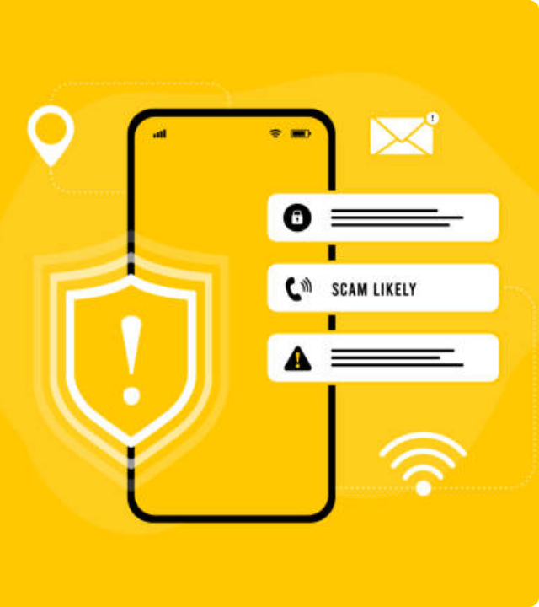
PROBLEM STATEMENT
Voice cloning technology allows scammers to impersonate trusted contacts using just 3 seconds of audio samples.
Critical Impact:
Global fraud losses exceed $10 Billion annually.
Psychological manipulation exploits human ears' vulnerability to synthetic speech.
Erosion of trust in digital voice communications and mobile banking.

Slide 6



AIM AND OBJECTIVES
Detection Precision
Low Latency
Privacy-First
Achieve at least 97% precision on benchmark datasets like ASVspoof.
Process audio in under 2 seconds to provide real-time scam alerts during live calls
Implement on-device inference to ensure call data never leaves the user's smartphone.

Slide 7
SCOPE AND LIMITATIONS
Category | Project Scope | Inherent Limitations
Platforms | Android/iOS, VoIP (WhatsApp) | Limited support for legacy PSTN lines
Languages | English, Hindi, Marathi | Struggles with heavy local accents
Environment | Real-time call monitoring | Degrades with high background noise

Slide 8
CHAPTER SCHEME
Chapter 1
Chapter 2
Chapter 3
Chapter 4
Chapter 5
Chapter 6
Chapter 7
Chapter 8
Introduction &
Objectives
Literature Review
Research Gap
Problem Statement
Aim and Objectives
Scope and
Limitations
Expected Results
References

Slide 9
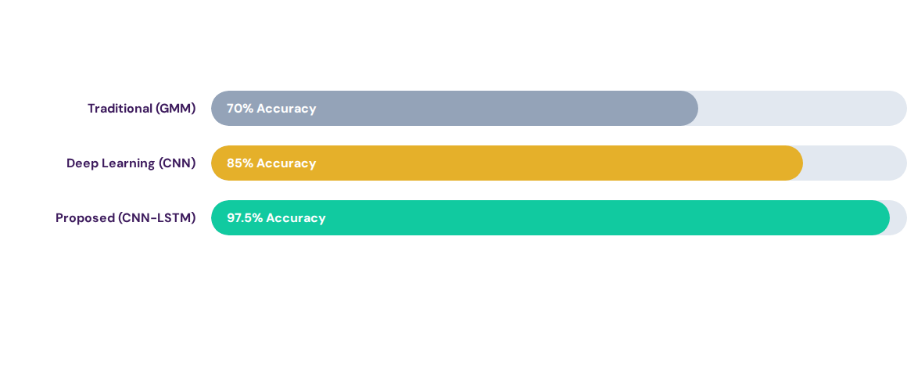
EXPECTED RESULT

Slide 10
REFERENCES
X. Liu et al., "ASVspoof 5: The Fifth Automatic Speaker Verification Spoofing Challenge," Interspeech 2024.
B.B. Gupta et al., "BERT and CNN-Based Phishing Detection in Enterprise Systems," 2024.
“Artificial Intelligence Act: Transparency Obligations for Deepfakes," European Union, 2024.
Shubham Gale | Nirmal Poreddiwar, "Deepfake Voice and Scam Call Detector," IJTSRD, March 2026.

Slide 11
Thank you !

